Slide 1
RATING PRICE PREDICTION
Submitted by – aman kumar patel
Batch – internship 25
Sme – md. kashif

Slide 2
INTRODUCTION
Business Problem Framing
A website has a forum for writing technical reviews of products and consists of repository of reviews for technical products. Now they are adding a new feature to their website i.e. The reviewer will have to add stars(rating) as well with the review. The rating is out 5 stars and it only has 5 options available 1 star, 2 stars, 3 stars, 4 stars, 5 stars. Now they want to predict ratings for the reviews which were written in the past and they don’t have a rating. An application to predict the rating by seeing the review is required to be built.
Therefore, a predictive model to accurately predict a user’s rating based on input review is required to be made.
Ratings are an important metric in e-commerce application to determine a product’s quality, consumer demand, worth and profitability. The sentiment of a user towards a product is reflected in their rating score and their review of the product. This helps determine how the product is perceived by the consumers and in turn gives an idea about the acceptance of the product by the consumers. There is a strong positive correlation between the rating of a product and its consumer demand. Therefore, it is necessary to build a predictive model which can, with good accuracy predict what rating a user might give a particular product based on the user review. This helps understand user sentiment towards a product and determine the product’s worth and acceptance by consumers.

Slide 3
Analytical Problem Framing
Mathematical/ Analytical Modeling of the Problem
Various Classification analysis techniques were used to build predictive models to understand the relationships that exist between user review and the corresponding user rating.
The user reviews are collected, processed and normalised. Based on the context of the reviews on various items, with similar ratings, prediction of the rating for a given review can be made based on similar reviews which already have corresponding ratings.
In order to predict ratings for user revies, models such as Logistic regression, Random Forest Classifier Boost Classifier, Extreme Gradient Boost Classifier, Multinomial Naïve Bayes Classifier, Complement Naïve Bayes Classifier and Passive Aggressive Classifier were used.
Data Sources and their formats
The Dataset was compiled by scraping User review and rating Data for various products from https://amazon.in and https://www.flipkart.com/
The data was converted into a Pandas Dataframe under various Comment and Ratings columns and saved as a .csv file.

Slide 4
Analytical Problem Framing
Data Preprocessing Done
Rows with null values were removed.
Columns: Unnamed: 0(just a series of numbers) was dropped since it doesn't contribute to building a good model for predicting the target variable values.
The train and test dataset contents were then converted into lowercase.
Punctuations, unnecessary characters etc were removed, currency symbols, phone numbers, web urls, email addresses etc were replaced with single words
Tokens that contributed nothing to semantics of the messages were removed as Stop words. Finally retained tokens were lemmatized using WordNetLemmatizer().
The string lengths of original comments and the cleaned comments were then compared.

Slide 5
Analytical Problem Framing
Data Inputs- Logic- Output Relationships
The comment tokens so vectorised using TfidVectorizer are input and the corresponding rating is predicted based on their context as output by classification models
Assumptions
The comment content made available in Dataset is assumed to be written in English Language in the standard Greco-Roman script. This is so that the Stopword package and WordNetLemmatizer can be effectively used.

Slide 6
Python Libraries used:
Pandas: For carrying out Data Analysis, Data Manipulation, Data Cleaning etc o Numpy: For performing a variety of operations on the datasets.
matplotlib.pyplot, Seaborn: For visualizing Data and various relationships between Feature and Label Columns
sklearn for Modelling Machine learning algorithms, Evaluation metrics, Data Transformation etc
imblearn.over_sampling: To employ SMOTE technique for balancing out the classes.
re, string: To perform regex operations
Wordcloud: For Data Visualization
NLTK: To use various Natural Language Processing Tools.
Exploratory Data Analysis Visualizations
Barplots, Countplots,Distplots,WordClouds were used to visualise the data of all the columns and their relationships with Target variable.

Slide 7
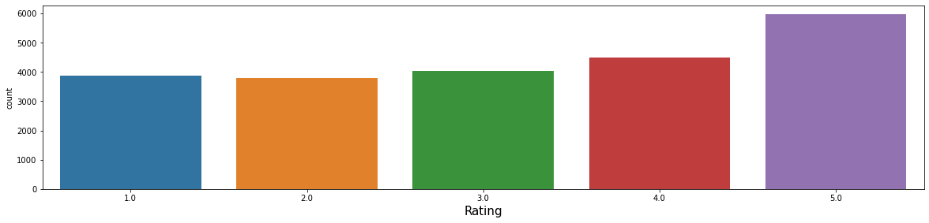
Analytical Problem Framing
Analyzing the Columns
The rating classes 1.0-4.0 are fairly balanced, the 5.0 class represents the highest number of reviews.

Slide 8
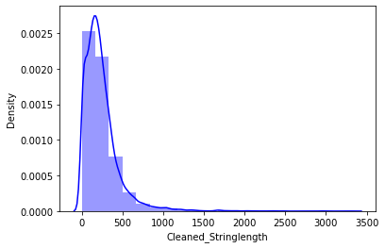
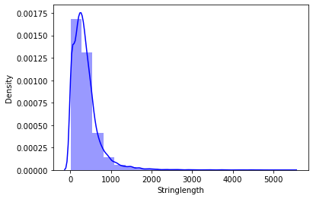
Analytical Problem Framing
Unprocessed vs Cleaned string lengths
Above graphs show that the string length of comments was drastically brought down after processing.

Slide 9
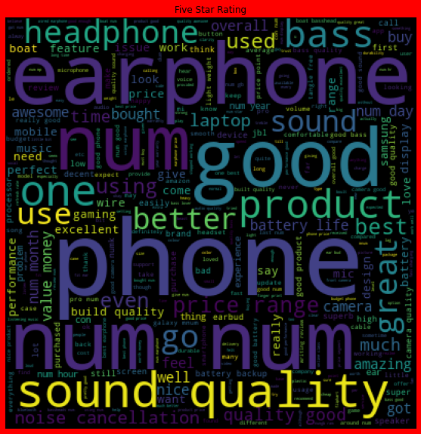
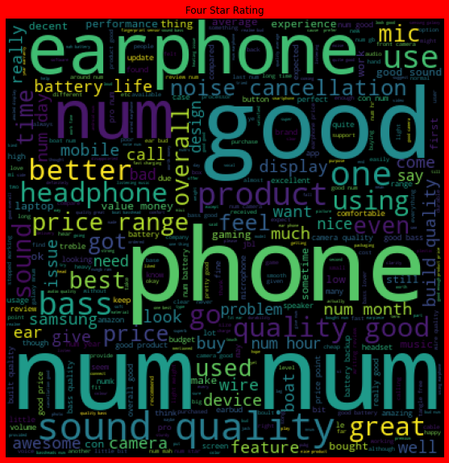
Analytical Problem Framing
Word Clouds of the most frequent words under used in reviews corresponding to various Rating Scores

Slide 10
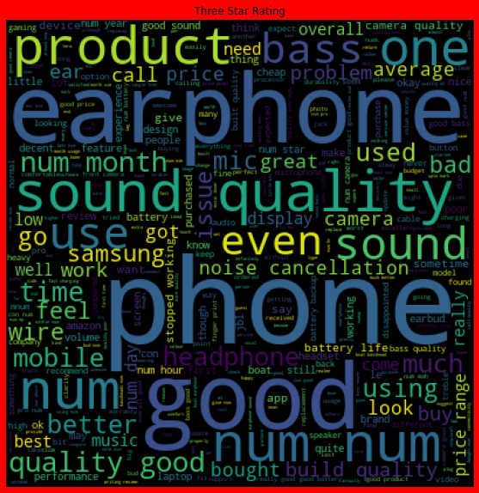
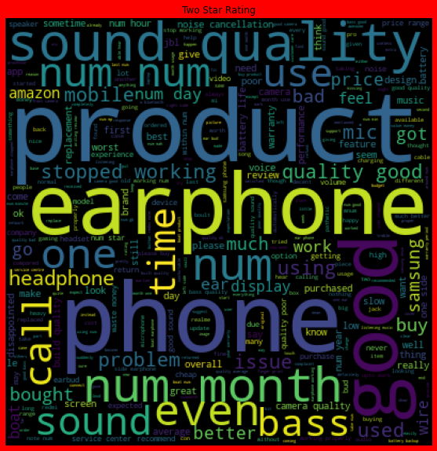
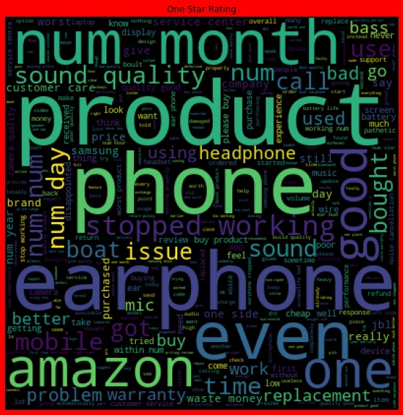

Slide 11
From the graphs above the following observations are made:
Reviews corresponding to 5.0 rating frequently carry words like: ‘great’,’best’,’perfect’,’better,’good’ etc indicating very high customer satisfaction and high quality product.
Reviews corresponding to 4.0 rating frequently carry words like: ‘good’,’better’,’nice’,’value money’,’decent’, ‘quality’,’awesome’ etc indicating high customer satisfaction and good quality product.
Reviews corresponding to 3.0 rating frequently carry words like: ‘good’,’well’,’purchased,’bad quality’,’issue’ etc indicating customer dissatisfaction and average to below average product quality.
Reviews corresponding to 2.0 rating frequently carry words like: ‘problem’, ‘replacement,’stopped working’,’worst experience’,’quality’ etc indicating high customer dissatisfaction and below average product quality.
Reviews corresponding to 1.0 rating frequently carry words like: ‘stopped’,’working’,’cheap’,’return’,’issue’,’wase money’,’poor quality’,’customer care’,’bad’,’used’,’worst’, ‘poor build quality’ etc indicate very high customer dissatisfaction and poor quality product.

Slide 12
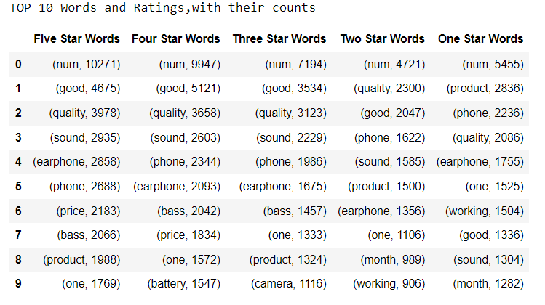
Top 10 words and their corresponding Ratings, along with their counts

Slide 13
Model/s Development and Evaluation
RandomForestClassifier: A random forest is a meta estimator that fits a number of classifying decision trees on various sub-samples of the dataset and uses averaging to improve the predictive accuracy and control over-fitting. A random forest produces good predictions that can be understood easily. It reduces overfitting and can handle large datasets efficiently. The random forest algorithm provides a higher level of accuracy in predicting outcomes over the decision tree algorithm .

Slide 14

Analytical Problem Framing
Smote Technique was used to balance out the classes in the Label Columns

Slide 15
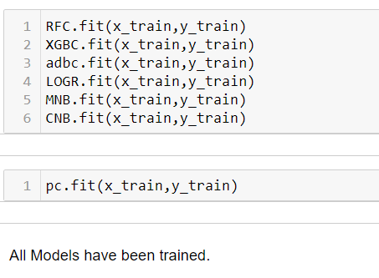
Training The Models

Slide 16
Model/s Development and Evaluation
Analyzing Accuracy of The Models
Classification Report consisting of Precision,Recall, Support and F1- score were the metrics used to evaluate the Model Performance. Precision is defined as the ratio of true positives to the sum of true and false positives. Recall is defined as the ratio of true positives to the sum of true positives and false negatives.The F1 is the weighted harmonic mean of precision and recall. The closer the value of the F1 score is to 1.0, the better the expected performance of the model is. Support is the number of actual occurrences of the class in the dataset. It doesn’t vary between models; it just diagnoses the performance evaluation process.

Slide 17
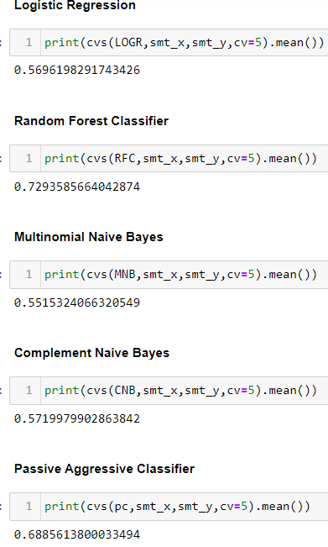
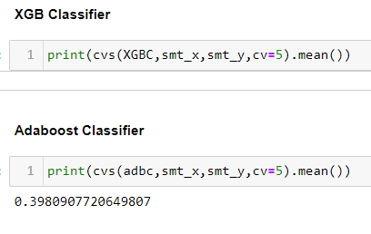

Slide 18
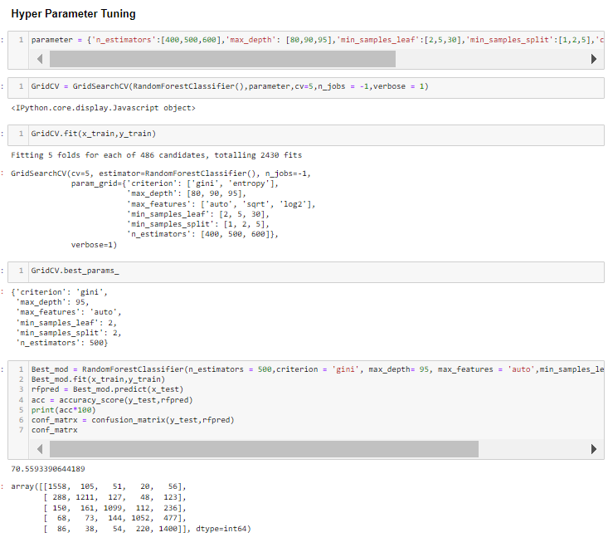
Hyper Parameter Tuning
GridSearchCV was used for Hyper Parameter Tuning of the Random Forest Classifier model.
Based on the input parameter values and after fitting the train datasets The Random Forest Classifier model was further tuned based on the parameter values yielded from GridsearchCV. The Random Forest Regressor model displayed an accuracy of 70.59%

Slide 19
CONCLUSION
Key Findings and Conclusions of the Study
The final model performed with 70.59% accuracy, Recall score of 0.81 for ratings 1.0 and 2.0, 0.75 for 3.0 rating score, 0.70 for 4.0 rating score and 0.69 for 5.0 rating score, which means that the model is optimized better to predict ratings for bad reviews and average reviews.
Learning Outcomes of the Study in respect of Data Science
Data cleaning was a very important step in removing null values from the dataset.
Visualising data helped identify class composition of label column and the most frequently occurring words in reviews corresponding to each of the rating scores.
The various data pre-processing and feature engineering steps in the project lent cognizance to various efficient methods for processing textual data. The NLTK suite is very useful in pre-processing text-based data and building classification models.
Limitations of this work and Scope for Future Work
A small dataset to work with posed a challenge in building highly accurate models. By training the models on more diverse data sets, longer comments, and a more balanced dataset, more accurate and efficient classification models can be built.

Slide 20

THANK
YOU

